Slide 1
Wall-Mounted Fan Research
Open Agriculture Initiative
Project: Large Tree Computer
2019-10-28

Slide 2
Non-Oscillating

Slide 3
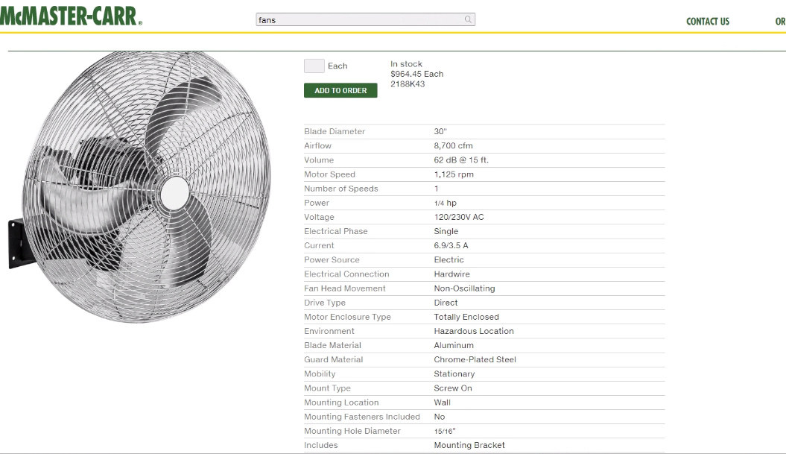

Slide 4
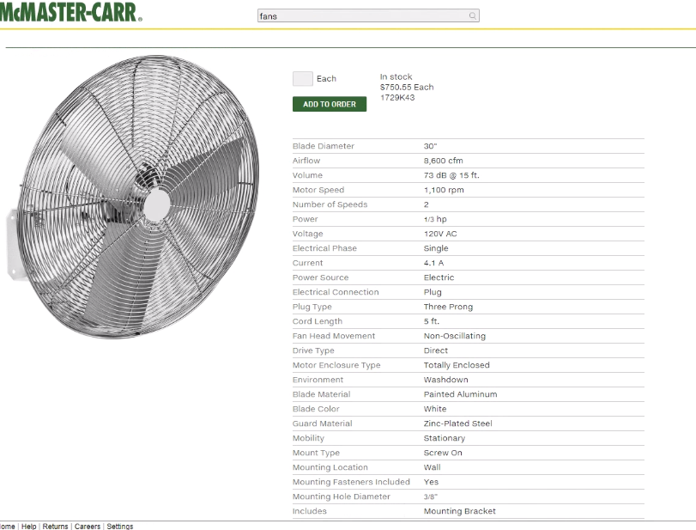

Slide 5
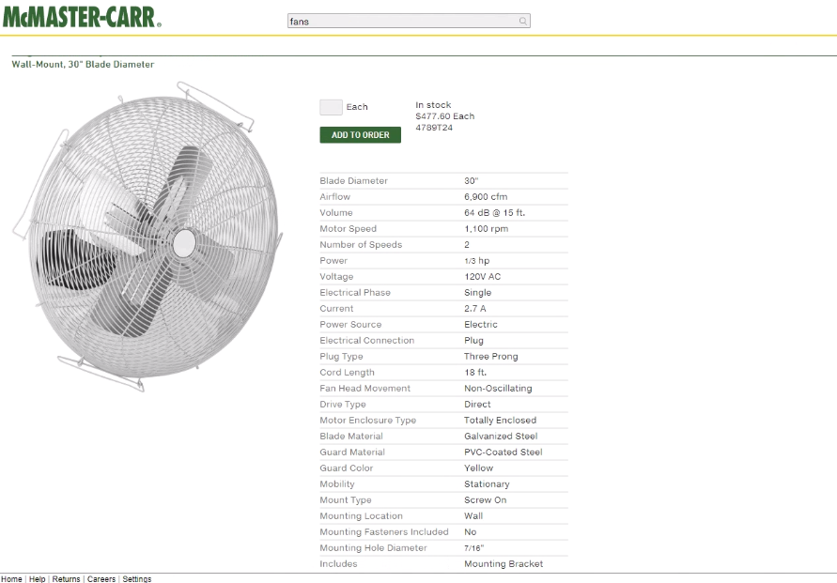

Slide 6
Non-Oscillating, Tilting

Slide 7
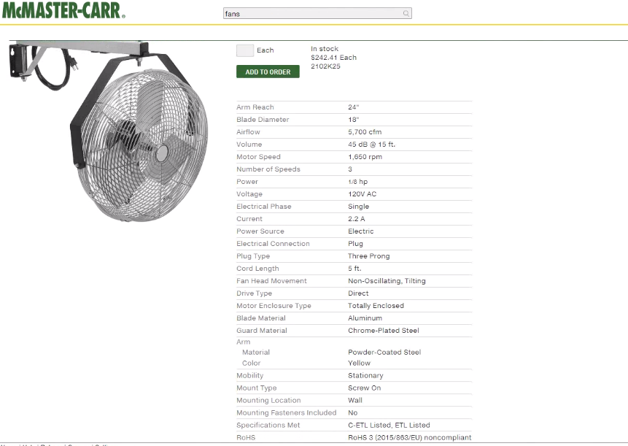

Slide 8
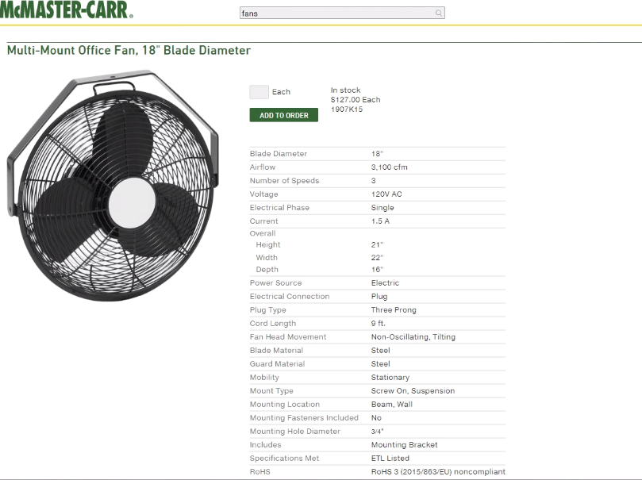

Slide 9
Oscillating

Slide 10
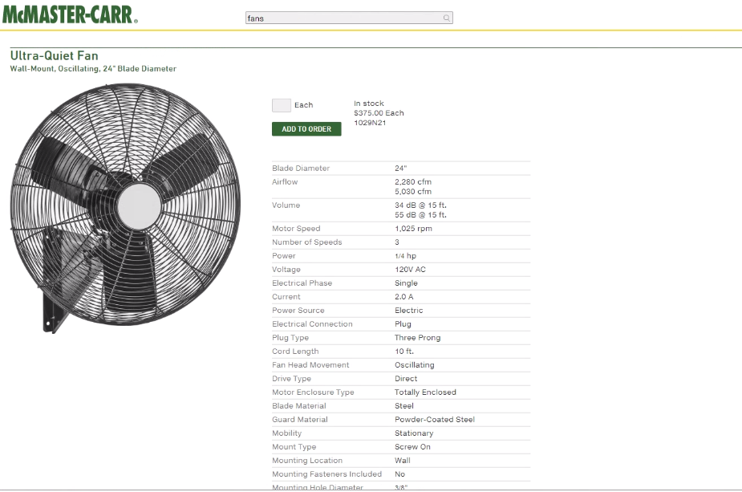

Slide 11
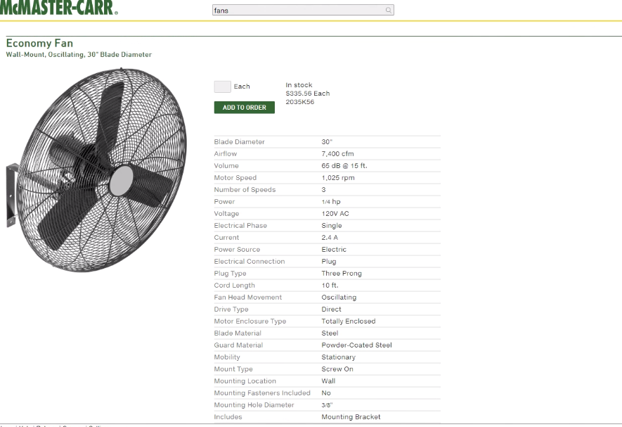

Slide 12
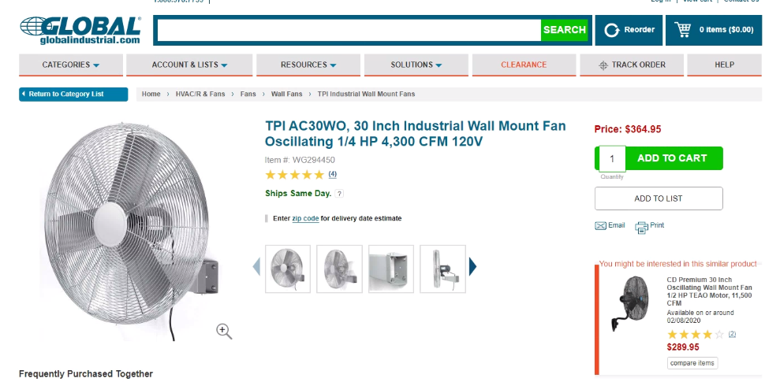

Slide 13
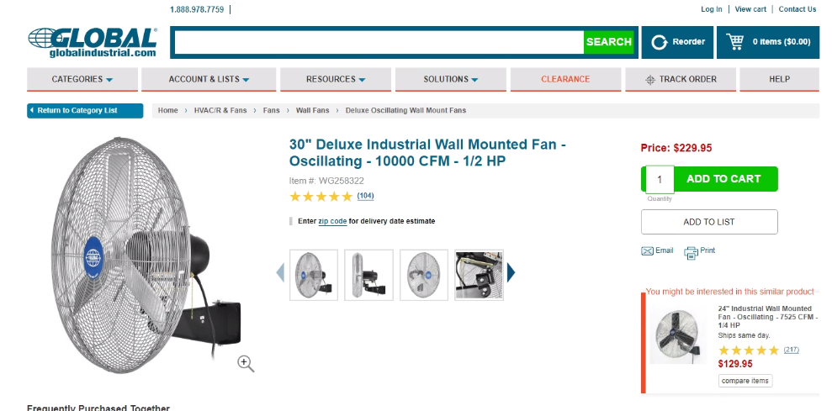

Slide 14
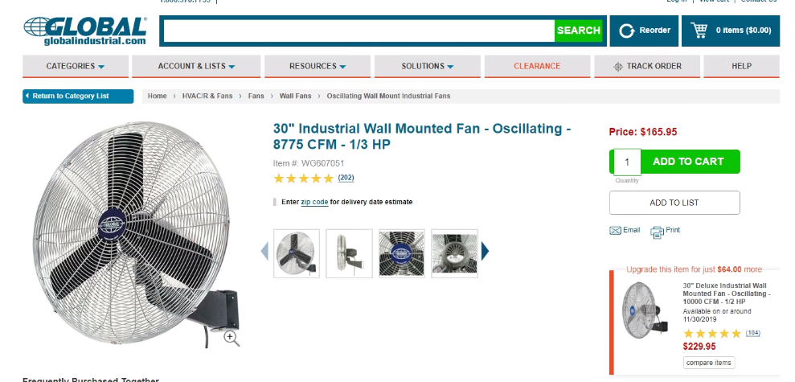

Slide 15
